Slide 1

XSEDE12 Panel: Security for Science Gateways and Campus Bridging
go.illinois.edu/xsede12secpanel
Jim Basney, Randy Butler, Dan Fraser, Suresh Marru, and Craig Stewart

Slide 2
Panel Agenda
Suresh Marru: Science Gateway Security
Craig Stewart: Campus Bridging Security
Dan Fraser: OSG Campus Grid Perspectives
Jim Basney: Identity/Access Management
Randy Butler: Operational Security
Discussion (30 minutes)
Slides at go.illinois.edu/xsede12secpanel

Slide 3
Science Gateway Security Challenges
go.illinois.edu/xsede12secpanel
Suresh Marru

Slide 4
Acknowledgments
TeraGrid Area Director for Science Gateways - Nancy Wilkins-Diehr
Amazing Science Gateway Staff
Gateway Use Case Gathering experts
Specially the gateway security focus leads:
Tom Uram, Shaowen Wang & Marlon Pierce

Slide 5
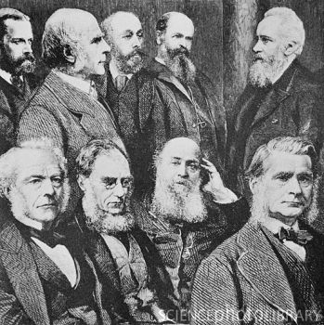

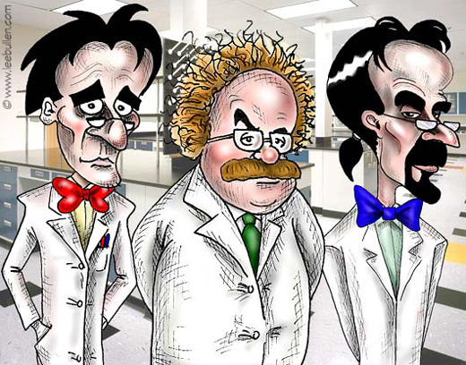


Are you a scientist?
Do you look like one of them?
Do you have these on your desk?
Darwin’s evolution of Computational Scientist ☺
We still do this, not just on science problems but more on catching up with emerging technologies (sometimes newer way of doing the same thing)…and yaa security, need more hair please …..

Slide 6








Science Gateways:
Enabling & Democratizing Scientific Research
Advanced Science Tools
Knowledge and Expertise
Computational Resources
Scientific Instruments
Algorithms and Models
Archived Data and Metadata

Slide 7


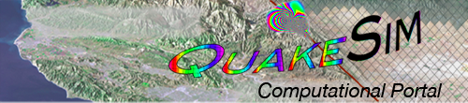
























Today, there are approximately 35 gateways using XSEDE
Notes:
Most popular these days is CIPRES- Phylogeny (Mark Miller)

Slide 8

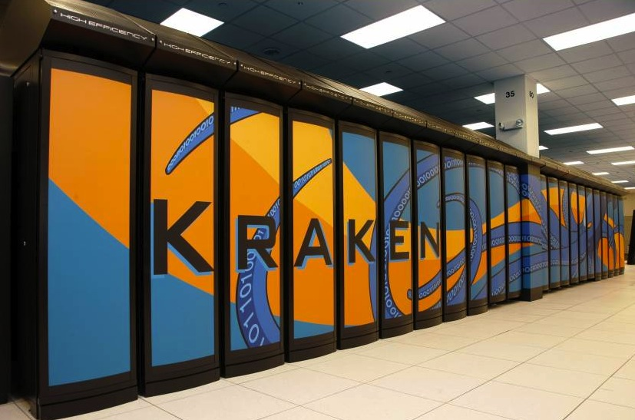
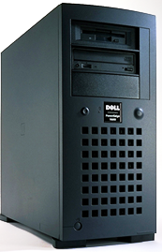
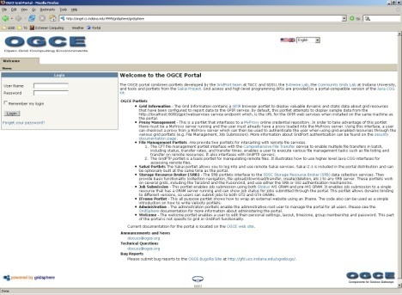

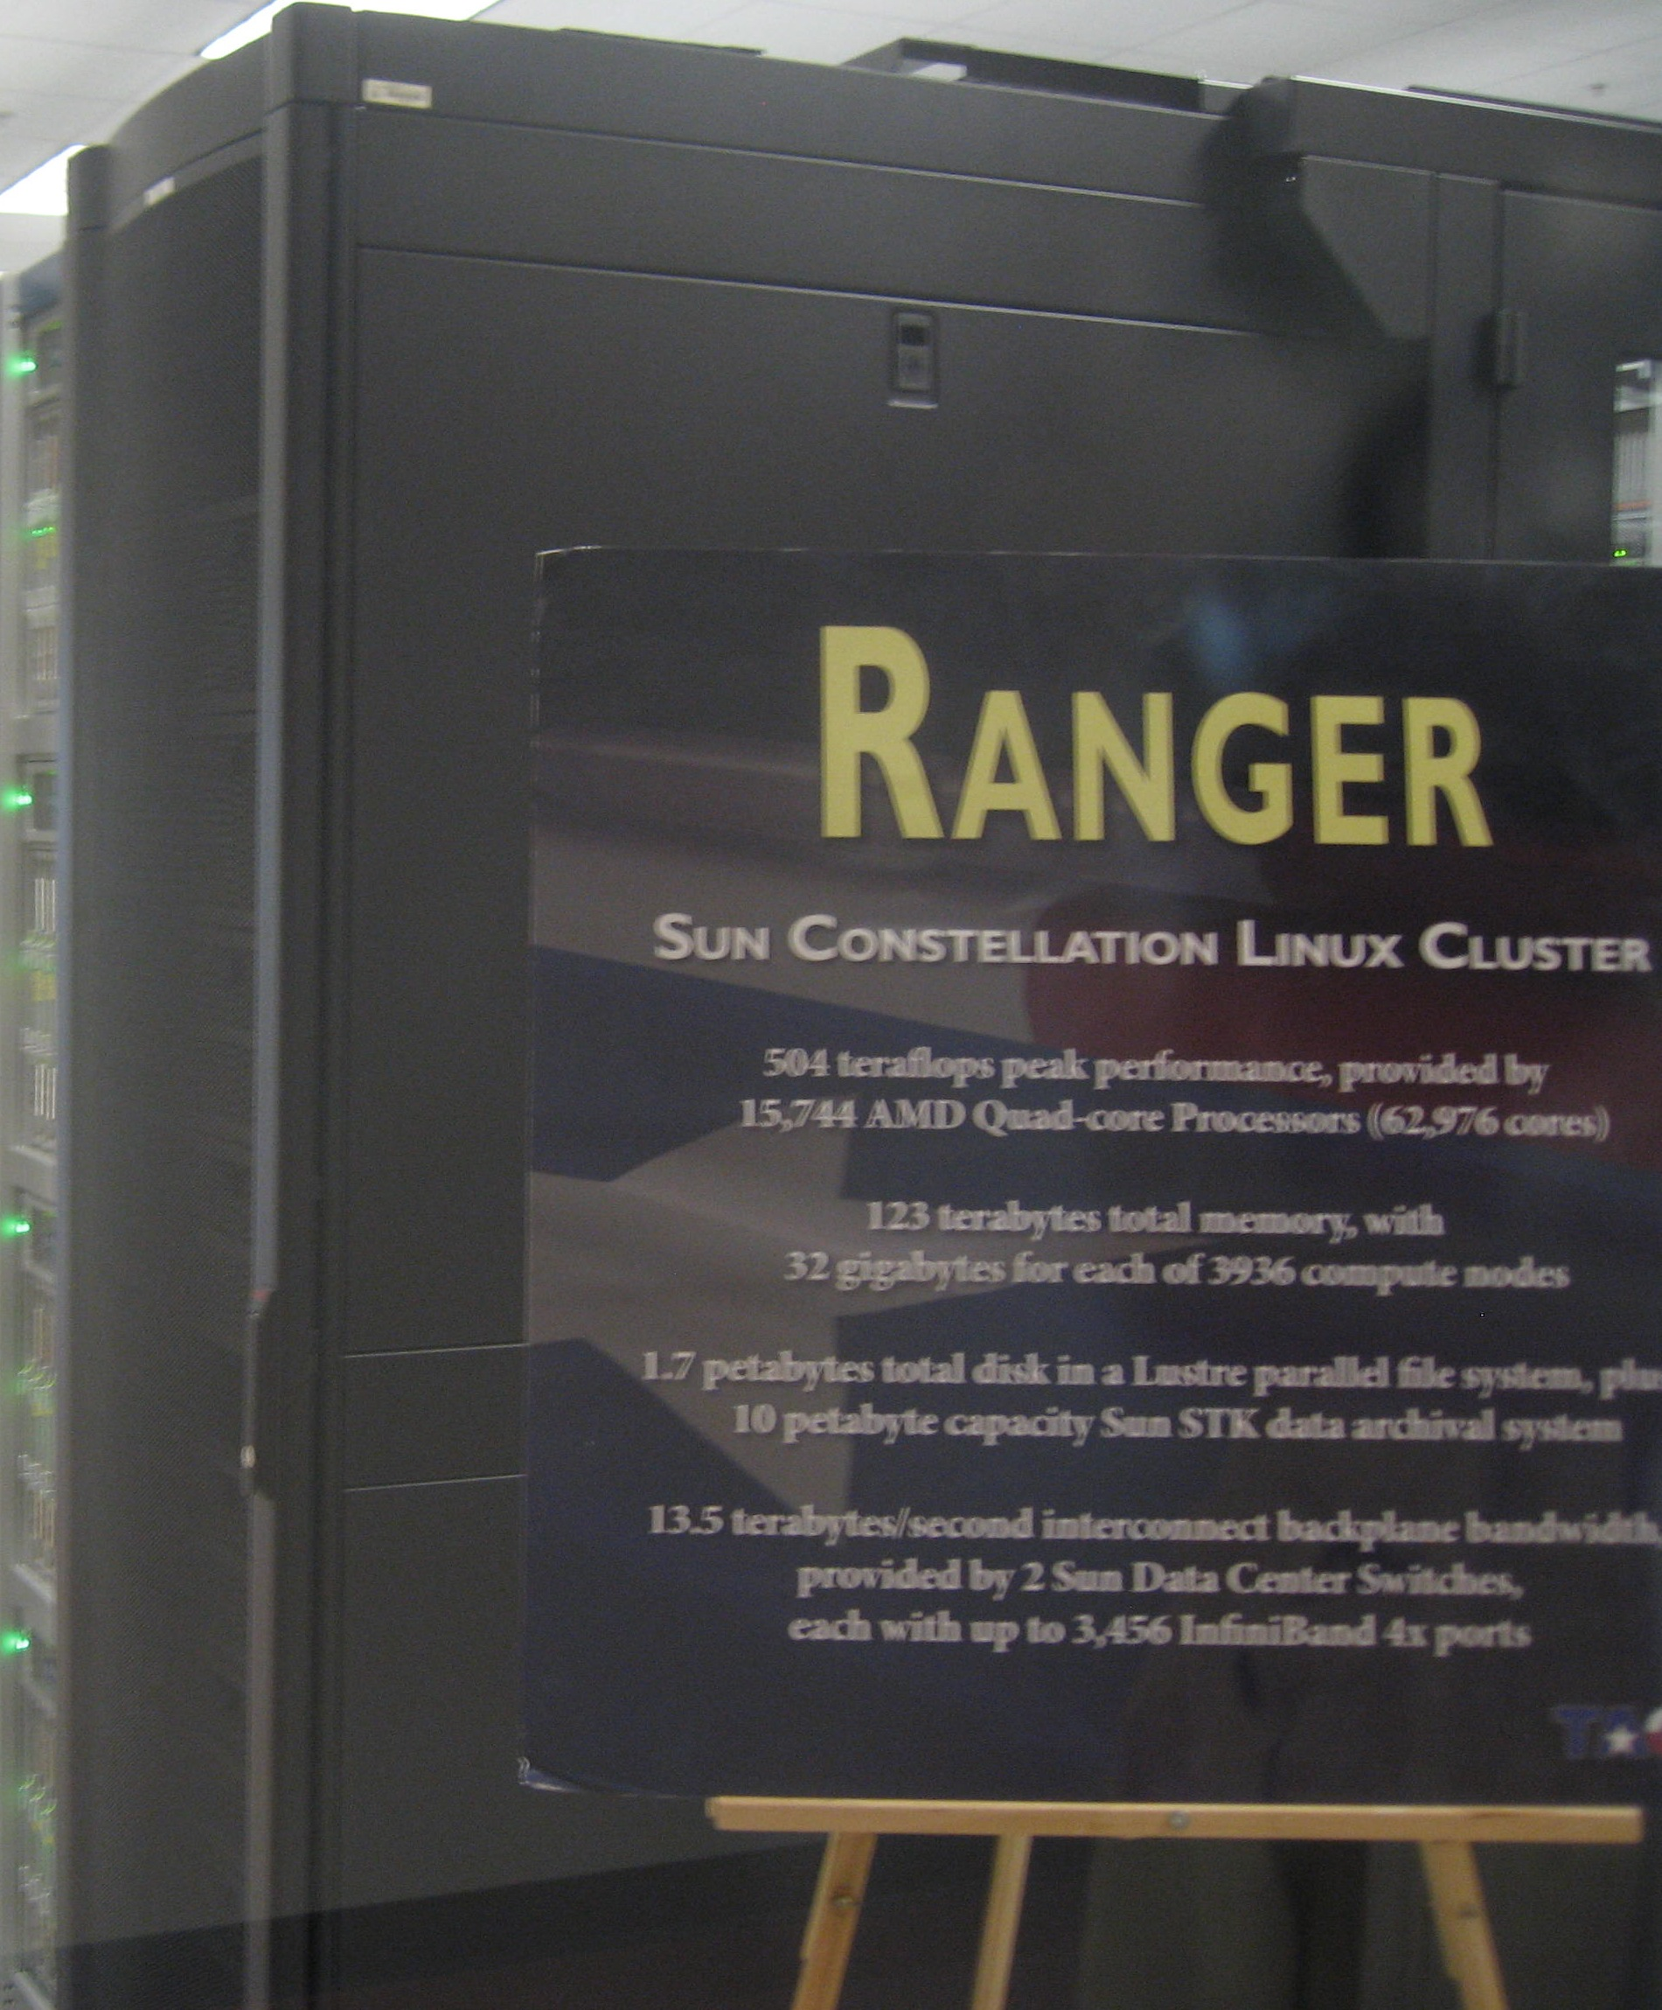
Simplified Gateway Architecture
XSEDE User Portal
Community Account Grid Certificate
username, password
Step 0
One time Gateway
Community Setup
Fetch Community Credential
Grid Proxy
Gateway Authentication
Proxy, Job Request
Step 1
Job Status, Output
Job Submit or
File Transfer request
Output
Gateway Interface
Step 2,3,,
Gateway Server
Compute Servers

Slide 9
Science Gateway Security Requirements
Gateways must be able to move data and submit jobs on behalf of end users, and monitor and restart those jobs.
Execution & data movement must be manageable by Gateway with no user involvement.
Security Credentials must be renewable to support long-running jobs.
Gateway has an XSEDE account/allocation but end users do not. They just have gateway accounts.

Slide 10
Gateway Security Needs Contd.
Currently there is a discontinuity between the portal identity management and the community credential used by the Gateway Services.
Gateways & XSEDE would like to know:
Who is using up all the community allocation hours?
Who was doing something that led to or was correlated with some security incident on the service provider?
How can we make it simple to create and manage user accounts without compromising service provider security?

Slide 11
Gateway security needs Contd..
Gateways would like to have a security frameworks interoperate with other resources they work with including commercial clouds.
Gateway would like to have a mechanism to protect data of individual users all routed through a common community credential.
Users should be able to upload data to a XSEDE resource brokered through a community credential.

Slide 12
Some Security risks
If the gateway credential is compromised, it can be used to submit arbitrary jobs on XSEDE resources.
The gateway credential will either store the encryption passphrase or have an unencrypted private key, both of which are security risks. Need better alternatives.

Slide 13
Campus Bridging Security Challenges
go.illinois.edu/xsede12secpanel
Craig Stewart

Slide 14
Campus Bridging
In early 2009 National Science Foundation’s (NSF) Advisory Committee for Cyberinfrastructure (ACCI) charged six different task forces: one of those was called Campus Bridging.
Cyberinfrastructure consists of computational systems, data and information management, advanced instruments, visualization environments, and people, all linked together by software and advanced networks to improve scholarly productivity and enable knowledge breakthroughs and discoveries not otherwise possible.
The goal of campus bridging is to enable virtual proximity:
the seamlessly integrated use among a scientist or engineer’s personal cyberinfrastructure; cyberinfrastructure on the scientist’s campus; cyberinfrastructure at other campuses; and cyberinfrastructure at the regional, national, and international levels; as if they were proximate to the scientist.
When working within the context of a Virtual Organization (VO), the goal of campus bridging is to make the ‘virtual’ aspect of the organization irrelevant (or helpful) to the work of the VO.
Notes:
CI definition from Educause/CACR joint workshop on Campus CI.
Bridging definition chosen by the Task force.

Slide 15
Challenges regarding campus bridging
It’s not a specific thing. You can’t point to a ‘campus bridge’ the way you can a supercomputer
There is no such thing as a ‘campus bridger’ the way there is a Campus Champion.
It may make sense to talk about a ‘bridged resource’
It’s more a mindset toward a particular form of technical interoperability and usability than it is a specific thing
The hardest thing about campus bridging: explaining a set of use cases that affects several types of XSEDE activities as campus bridging
The second hardest thing: getting colleagues to abandon the idea that groups interested in campus bridging are XSEDE Service Provider wannabees.

Slide 16
InCommon authentication
Need for education, information
3rd party providers (for people at small institutions and international partners)?
2 factor authentication?

Slide 17
Shared Virtual Compute Facilities
SVCF – virtual cluster independent of XSEDE
Can we provide tools that will create authentication screens that look and work like XSEDE login
Doing this requires supporting multiple authentication mechanisms
Remember: not everyone one wants to have an XSEDE label on their organization!
SVCF – accepting jobs from XSEDE
Requires ability for SVCFs to accept jobs (and trust) XSEDE
Requires ability for XSEDE to trust SVCFs
Requires trouble ticket exchange and security notification / response processes
This sort of SVCF may be a type of entity that one could meaningfully call a ‘bridged resource.’

Slide 18
Data security
Provenance of non-sensitive data
Sensitive data!

Slide 19
Security for OSG Campus Bridging
Dan Fraser
OSG Production Coordinator
Campus Infrastructure Lead
XSEDE12
Chicago, IL
July 18, 2012

Slide 20
The Open Science Grid
The Open Science Grid (OSG) has focused its effort on campuses from its inception
All OSG computing power comes from campuses and National Laboratories
OSG has a footprint on over 100 campuses and labs in the US and abroad

Slide 21
OSG Sites

Slide 22
OSG Campus Security 50,000 ft view
Identity
Campus identities are good enough
Users are not required to have certificates
Although specific OSG sites may require them
Virtual Organizations (VOs) need certificates
Trust
Primarily between sites and the VOs
Users are vetted by a VO and submit jobs using a VO credential
If there is an issue, sites can simply ban the VO

Slide 23


Let’s start from the campus ...
Campus
PBS /LSF
Pair-wise trust Relationship
Campus Credentials
Submit Host Credential
Condor
Local Cluster
Bosco Submit
Host/Gateway
Clusters each trust the Submit Gateway

Slide 24
This also works inter-campus
Campus 1
Campus 2
PBS /LSF
Pair-wise trust Relationship
Campus Credentials
Submit Host Credential
Condor
Local Cluster
Bosco Submit
Host/Gateway
But pairwise trust relationships don’t scale to O(10)

Slide 25

And Extends to the OSG
Campus
Open Science Grid
OSG Compute Element
Campus Credentials
Grid Service Credential
Local Clusters
Bosco Submit
Host/Gateway
VO Submit
Host/Gateway
Campus Submit Gateway Builds on VO Trust Relationships

Slide 26
OSG Campus Model
Help the researcher use local resources
Run on a local cluster (on campus)
Run on several local clusters
Use/share resources with a collaborator on another campus
Access the national cyberinfrastructure
OSG (and also XSEDE) resources
Submit Locally, Run Globally

Slide 27
Summary
The Bosco submit model enables the “Submit Locally, Run Globally” paradigm
OSG is exploring how best to collaborate with XSEDE on campus bridging
Bosco can also submit to XSEDE resources
OSG is a service provider to XSEDE

Slide 28
Identity/Access Management (IAM) for Science Gateways and Campus Bridging
go.illinois.edu/xsede12secpanel
Jim Basney

Slide 29
IAM in XSEDE Today
Individual users
User Portal logins
XSEDE Central Database (XCDB) user records
XSEDE allocations process
X.509 certificates for single sign-on
InCommon identities mapped to XCDB user records
Command-line access to local accounts at XSEDE SPs
AMIE provides XSEDE-wide account and allocation management
Science Gateway users
User identity/access managed by science gateway
Community accounts at XSEDE SPs
Community certificates (X.509) containing user attributes (SAML)
MyProxy OAuth Service for using individual XSEDE logins with gateways
Campus Bridging
Brave new world!

Slide 30
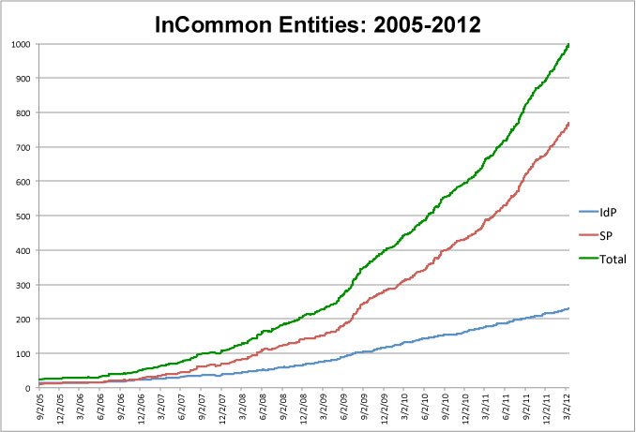
InCommon is the federation for U.S. research and education, providing higher education and their commercial and non-profit partners with a common trust framework for access to online resources.

Slide 31
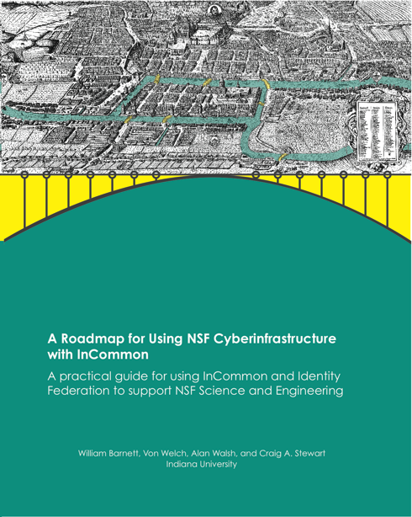
References: Federated IDM for CI
A Roadmap for Using NSF CyberInfrastructure with InCommon (http://www.incommon.org/nsfroadmap)
An Analysis of the Benefits and Risks to LIGO When Participating in Identity Federations (http://www.google.com/search?q=LIGOIdentityFederationRiskAnalysis.pdf)
Federated Security Incident Response (https://spaces.internet2.edu/x/8o6KAQ)

Slide 32
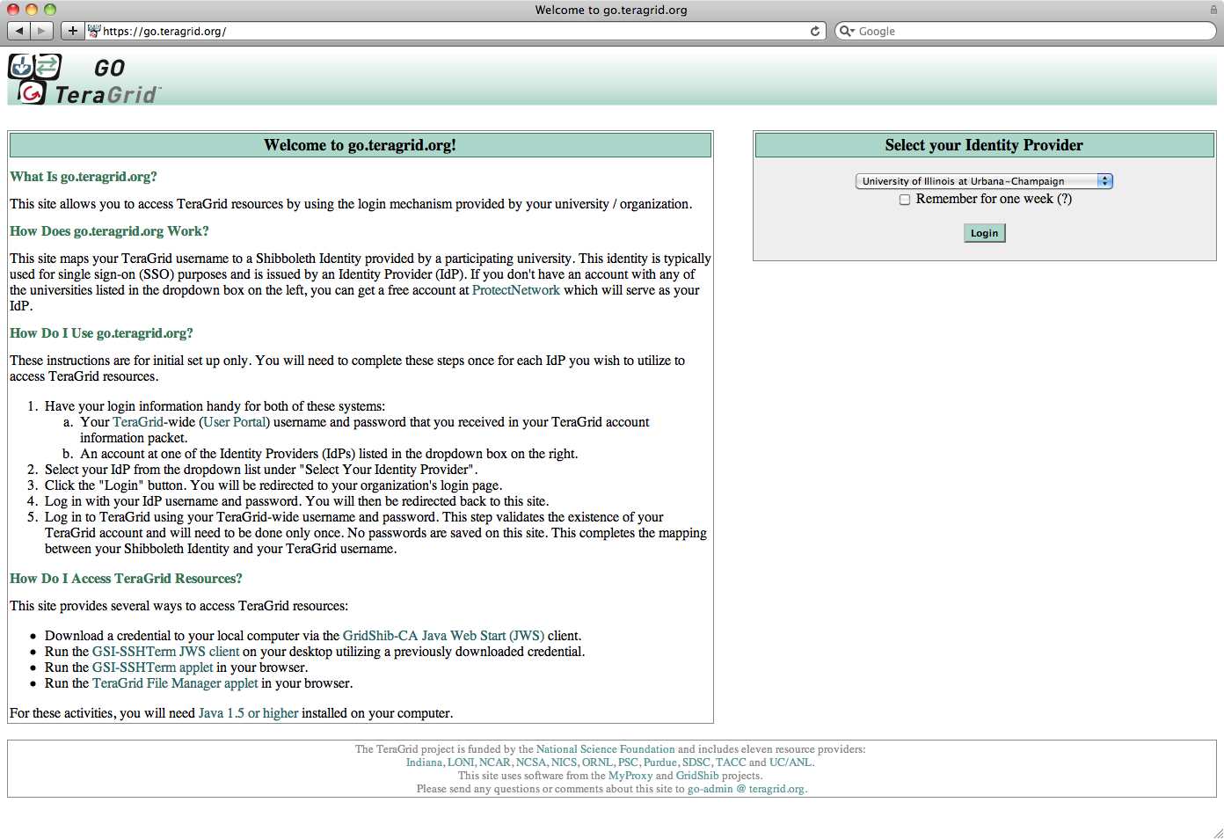
Prior Work: go.teragrid.org
Campus login to TeraGrid
35 campus IdPs
Relied on TeraGrid identity vetting
In production since September 2009
1000+ certificates issued to 65+ users
IGTF accredited
IDtrust 2010 paper: “Federated Login to TeraGrid” (http://dx.doi.org/10.1145/1750389.1750391)

Slide 33
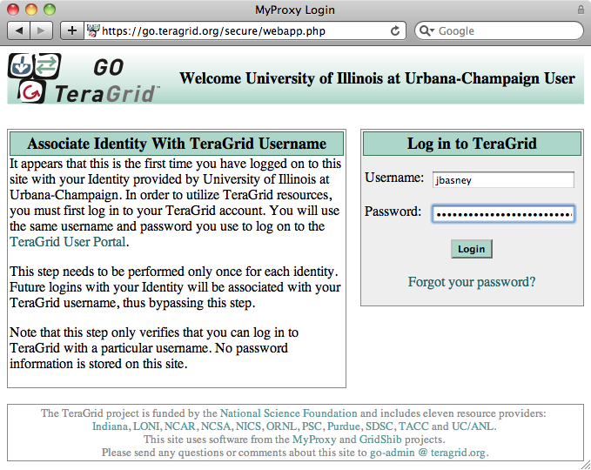
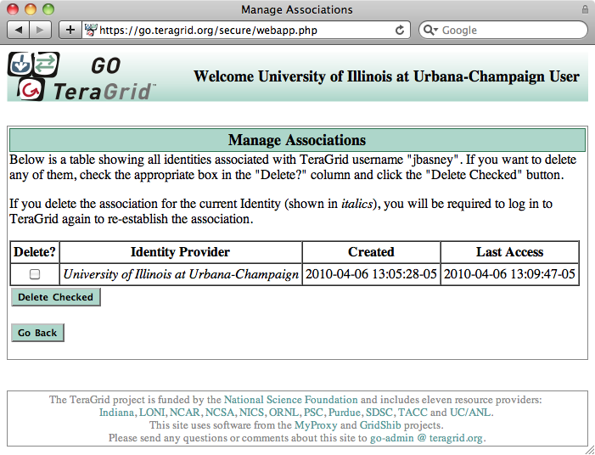
Account Linking
(one-time only)
Notes:
On the first login only, the researcher also logs in to TeraGrid to link the campus and TeraGrid identities (on the left).
The researcher can later delete account links via the web app (on the right).

Slide 34
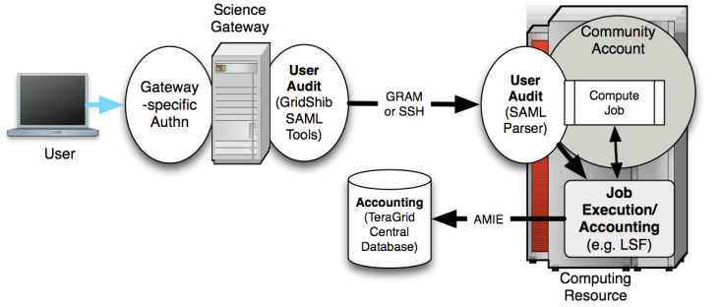
TeraGrid Science Gateway AAAA Model
http://dx.doi.org/10.1145/1838574.1838576

Slide 35

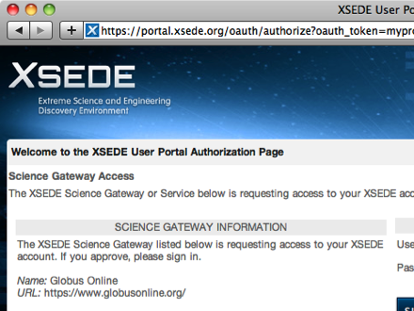
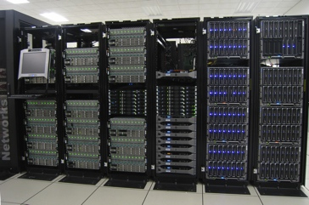
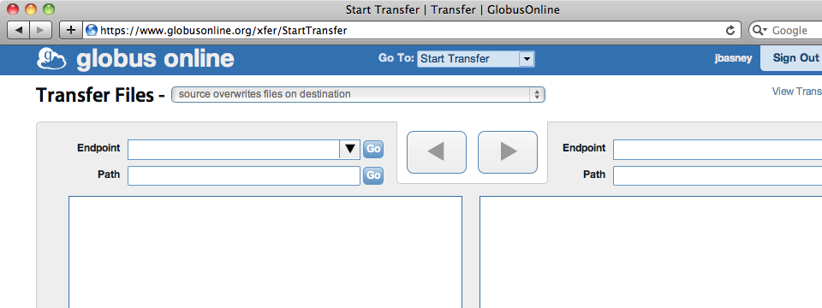
MyProxy OAuth
www.sciencegatewaysecurity.org

Slide 36
IAM Challenges
Federated identity management
Identities recognized across SPs, gateways, and campuses
Addressing requirements of operators/providers
Federated access management
Access granted by XSEDE allocations, gateways, campuses, and individual researchers
Interoperability
Web browser, command-line, API
Interactive, batch, workflow
Policies and mechanisms across boundaries (campus, nation, cyberinfrastructure)

Slide 37
Looking Forward
Continued decentralization of IAM
Decreasing role of XCDB as the source of IDs
Science Gateway community accounts an early example
Limited role for XSEDE Resource Allocations Committee (XRAC)
Authorization decisions made by science gateways, campuses, and individual researchers
Ongoing need for credential translation (password, X.509, Kerberos, SAML, OAuth)
Struggle to make this transparent and reliable
Avoid the need for “special case” approaches
Use campus (InCommon) IDs rather than creating XSEDE IDs
Also support Facebook / Google IDs?
Migrate from the command-line to the web/cloud

Slide 38
Operational Security for Science Gateways and Campus Bridging
go.illinois.edu/xsede12secpanel
Randy Butler

Slide 39
Introduction
Randy Butler – XSEDE Security Officer
Jim Marsteller – XSEDE Assistant Security Officer
XSEDE Security Operations
Responsible for oversight on XSEDE’s operational security
Security Coordination for the XSEDE Service Providers
Indiana, Purdue, PSC, NCAR, NCSA, NICS, OSG, SDSC, TACC
Day-to-day security operations
Incident response
Software Security Reviews
Operational Testing and Configuration
Development and Deployment of XSEDE Security Services

Slide 40
Security Operations Science Gateway Challenges
Establishing Trust
Providers
Users
Account Auditing
Security Patch Management
Security Incident Coordination
Concerns over handling of security credentials.
Community Accounts
Scaling beyond a half dozen SGs

Slide 41
Science Gateway Open Issues
Science Gateway Trust
Can/should we leverage software security reviews?
Documenting guidelines and policies
Can we leverage the outcomes of the NSF Security for Science Gateways award
Educating users to consider carefully before handing their security credentials to a gateway
Establish a science gateway security contacts
Incident response team
Security patch management
Scaling

Slide 42
Security Operations Challenges Campus Bridging (CB)
Communication & Coordination
Incident response
Distributing important/sensitive information
Trust among participants
Undocumented risks, threats and vulnerabilities
Identifying Campus Bridging Security Configuration
Security requirements and expectations – both directions
Identifying New Policies
Mentoring & Supporting CB security staff

Slide 43
Campus Bridging Open Issues
What communication/coordination mechanism(s)?
How to best document Risks, threats, & vulnerabilities?
How to best document guidelines, policies, process?
Do we need a CB MOU?
Should we have CB security focused training?
What about a CB security focused forum?
Should we partner each CB with an established site – initially an SP, later maybe a senior CB.

Slide 44
Discussion
go.illinois.edu/xsede12secpanel

Slide 45
Discussion Topics
What are the top security challenges?
What are the use cases?
What are the best paths forward?
Any other comments/questions for panelists?

Slide 46
Poll the Audience – Show of Hands
Who has used InCommon/Shibboleth to log in to an off-campus site?
Who has used a Facebook/Google ID to log in to a third-party site?
Who uses a web browser to access cyberinfrastructure?
Who uses a command-line interface?

Slide 47

go.illinois.edu/xsede12secpanel

